Slide 1
Asia’s
Environmental
Issues
Pollution of the Yangtze and Ganges Rivers &
Air Pollution and Flooding in India and China
© Brain Wrinkles

Slide 2
Pollution of the
Ganges
River
© Brain Wrinkles

Slide 3
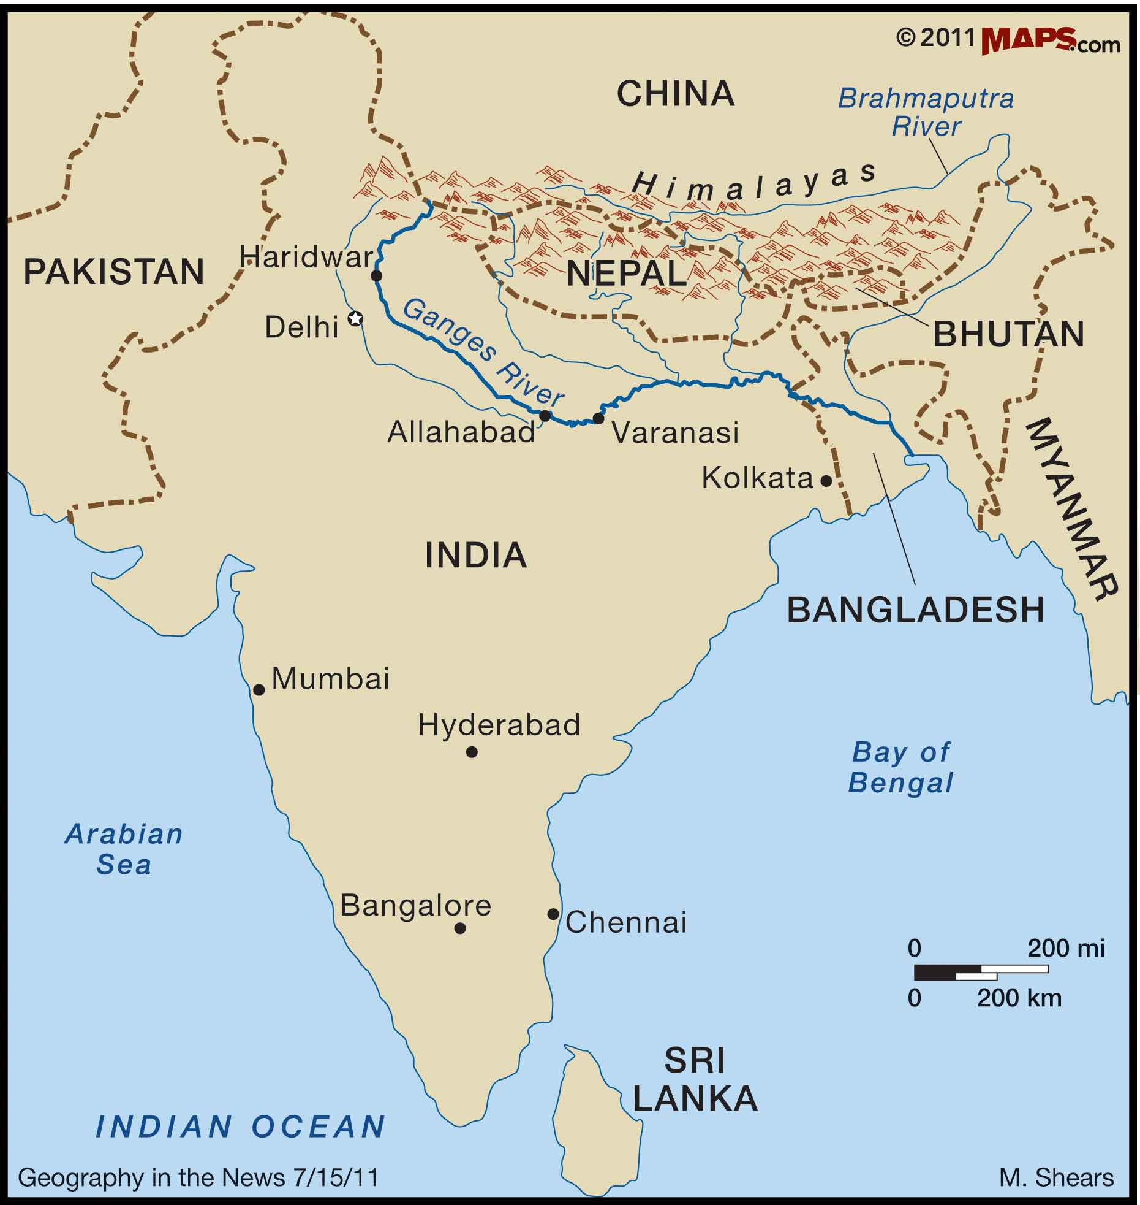
© Brain Wrinkles

Slide 4
Ganges River
The Ganges River is the most important river to the Indian subcontinent.
The Ganges River basin is one of the most densely populated place in the world.
The river provides water for drinking, bathing, cooking, and for transportation for over 400 million people who live in the region.
© Brain Wrinkles

Slide 5
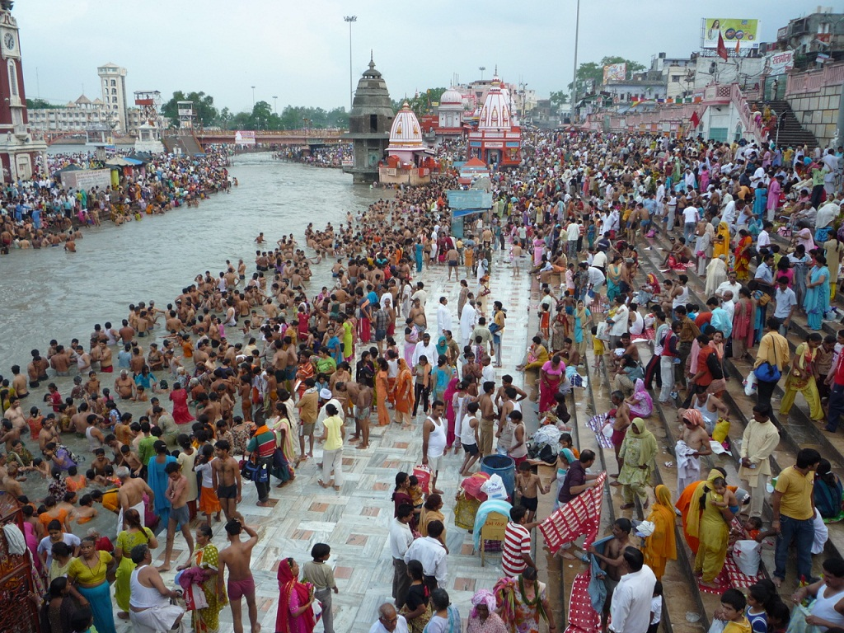
© Brain Wrinkles

Slide 6
Pollution
Many of India’s largest and most industrial cities are located in the Ganges River basin, and these factories dump their wastes into the river.
About two million tons of chemical, human, and agricultural waste pours into the Ganges every day.
Cities pour millions of gallons of sewage into the river that is eventually carried to villages farther south.
© Brain Wrinkles

Slide 7
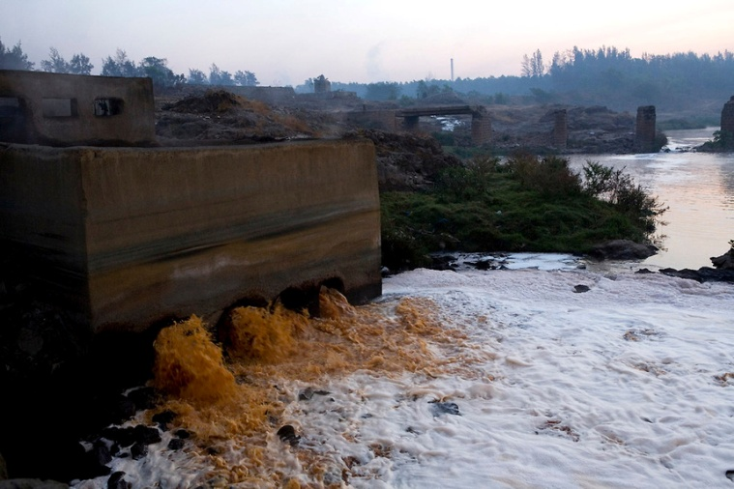
© Brain Wrinkles

Slide 8
Pollution
The Ganges is nicknamed “Mother Ganges”, and it is very sacred to the Hindu religion.
Hindus believe that they will have a peaceful journey to the next life if their ashes are scattered into the Ganges.
Many are too poor for cremation, so they place the bodies in the water instead.
© Brain Wrinkles

Slide 9
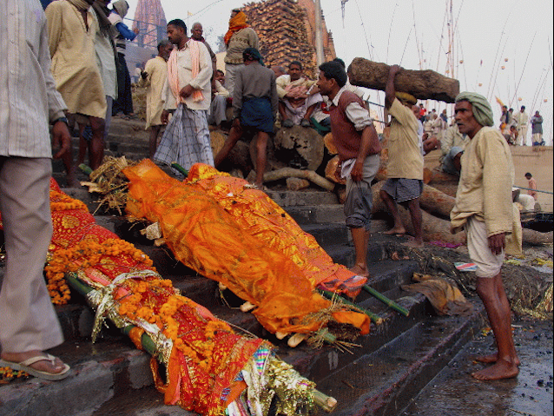
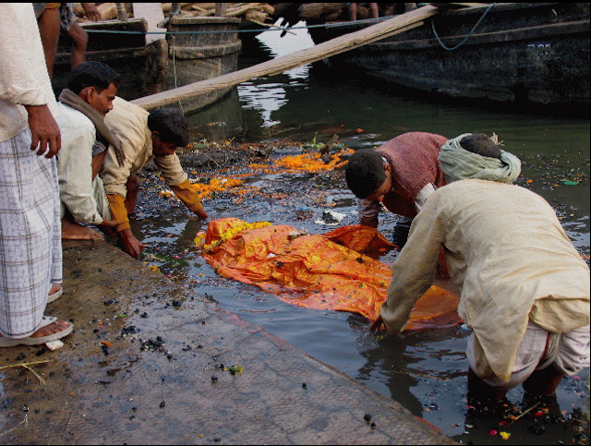
© Brain Wrinkles

Slide 10
Effects
The Ganges River is highly polluted with dangerous bacteria.
Cities along the Ganges have the highest rates of water-born diseases (found in drinking water) of any who live in India.
© Brain Wrinkles

Slide 11
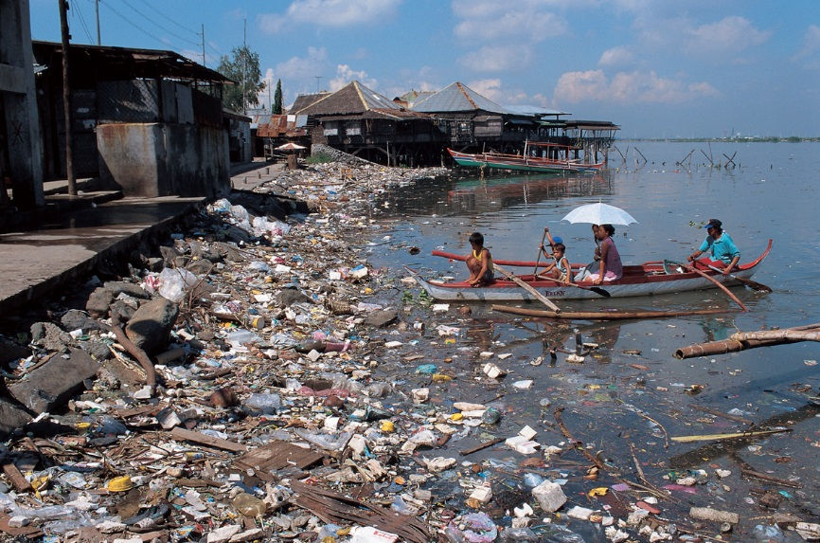
© Brain Wrinkles

Slide 12
Effects
It is estimated that about 80% of all illnesses and one-third of deaths in India come from drinking contaminated water.
Outbreaks of such diseases as cholera, dysentery, typhoid, and hepatitis are common.
© Brain Wrinkles

Slide 13
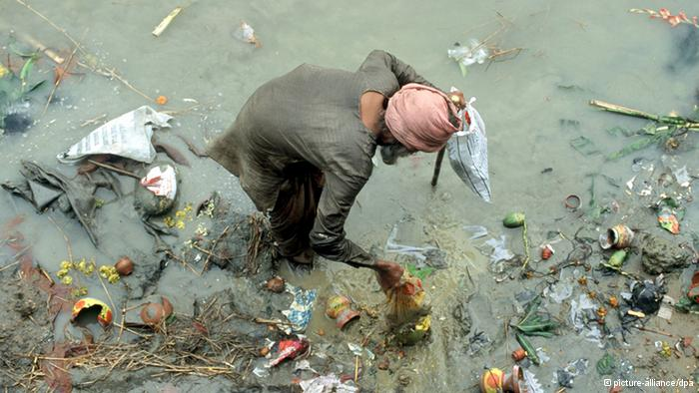
© Brain Wrinkles

Slide 14
Solution?
India’s government started a program in 1985 called the Ganges Action Plan, with the purpose of cleaning up the river.
Indians have built many sewage and water treatment plants along the river.
Unfortunately, it has not proved to be enough as India’s growing population and the run-off from industrial and farm production continue to pollute the river.
© Brain Wrinkles

Slide 15
Pollution of the
Yangtze
River
© Brain Wrinkles

Slide 16
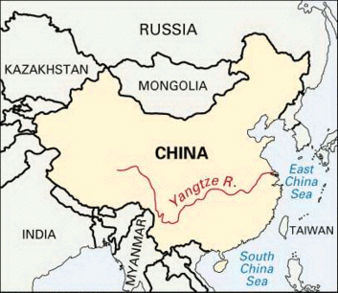
© Brain Wrinkles

Slide 17
Yangtze River
The Yangtze begins in the Tibetan Plateau and flows nearly 4,000 miles through 185 towns where 400 million people live.
It is an extremely important water source to at least one-third of China’s population.
Pumping stations along the river take water out to supply people with water for drinking, irrigation, and industrial uses.
© Brain Wrinkles

Slide 18
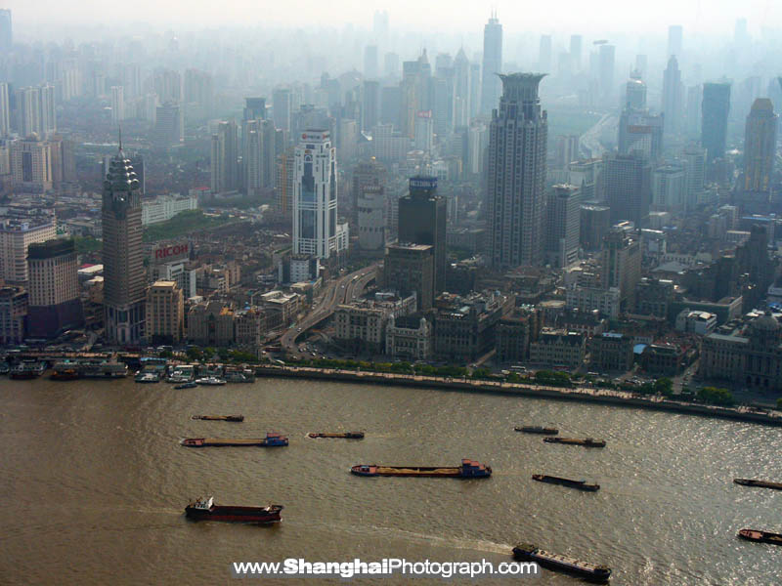
Yangtze in Shanghai
© Brain Wrinkles

Slide 19
Pollution
Many of China’s most densely populated and industrial cities are located along the river.
Billions of tons of chemicals and waste from agriculture, industry, and humans pour into the river each year.
Nitrogen from fertilizers and arsenic (poisonous chemical) from industrial uses are the leading pollutants in the river.
© Brain Wrinkles

Slide 20
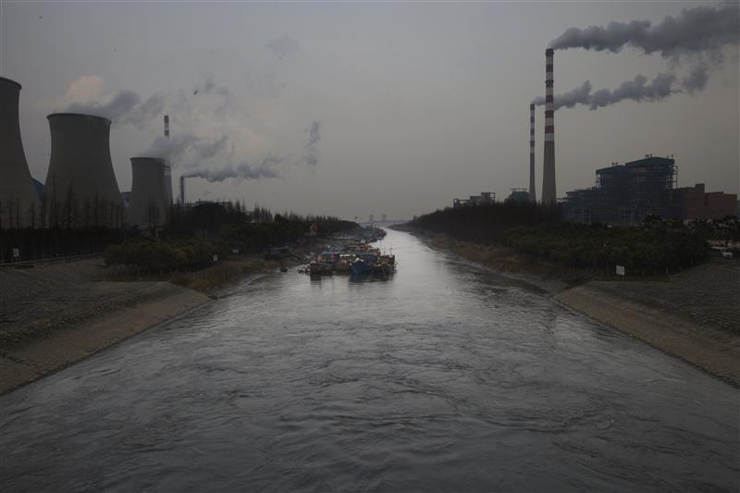
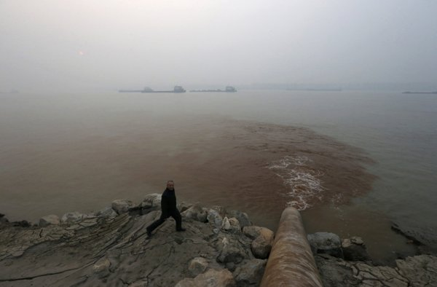
© Brain Wrinkles

Slide 21
Effects
The pollution puts all of the cities along its banks at risk.
Lakes and underground aquifers have also been contaminated.
Hundreds of millions of Chinese villagers do not have safe drinking water because of the pollution.
© Brain Wrinkles

Slide 22
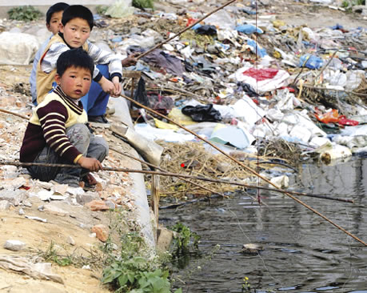
© Brain Wrinkles

Slide 23
Effects
Many species of plants and animals are dying.
Nitrates from farm run-off has caused algae in the water to multiply and is contaminating and killing the fish.
Chinese people are eating the sick fish, which has led to many health problems.
© Brain Wrinkles

Slide 24
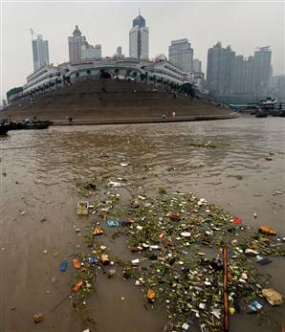
© Brain Wrinkles

Slide 25
Solution?
The Chinese government is building more water treatment facilities along the Yangtze’s banks.
It is encouraging cities to build sanitary landfills for garbage rather than dumping it into the river.
The government is spending billions of dollars to start cleaning up the Yangtze River, but it will take a long time to solve the pollution problem.
© Brain Wrinkles

Slide 26
Flooding in
INDIA
© Brain Wrinkles

Slide 27
Monsoons
In India, monsoon season begins in June and spreads heavy rain until September.
Monsoons are both a blessing and a curse for India.
Farmers rely on the rain to grow crops and it’s also used to generate electricity.
Unfortunately, monsoons also cause heavy floods where the rivers overflow and cause mass destruction and spread water-borne diseases.
© Brain Wrinkles

Slide 28
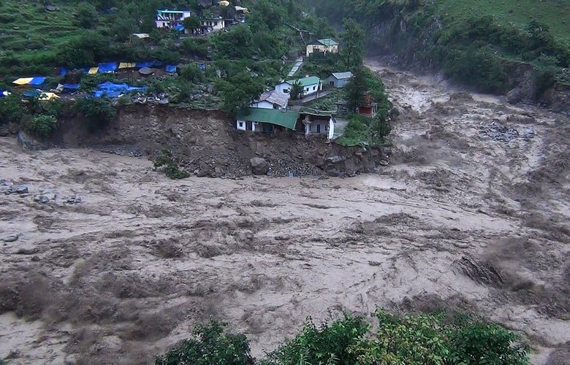
© Brain Wrinkles

Slide 29
Flooding
When monsoon flooding is too severe, the rivers overflow their banks and water sweeps over the land.
This can cause airports to close, buildings to collapse, power lines to fall, water-borne illnesses to spread, and animals and humans to possibly drown.
© Brain Wrinkles

Slide 30
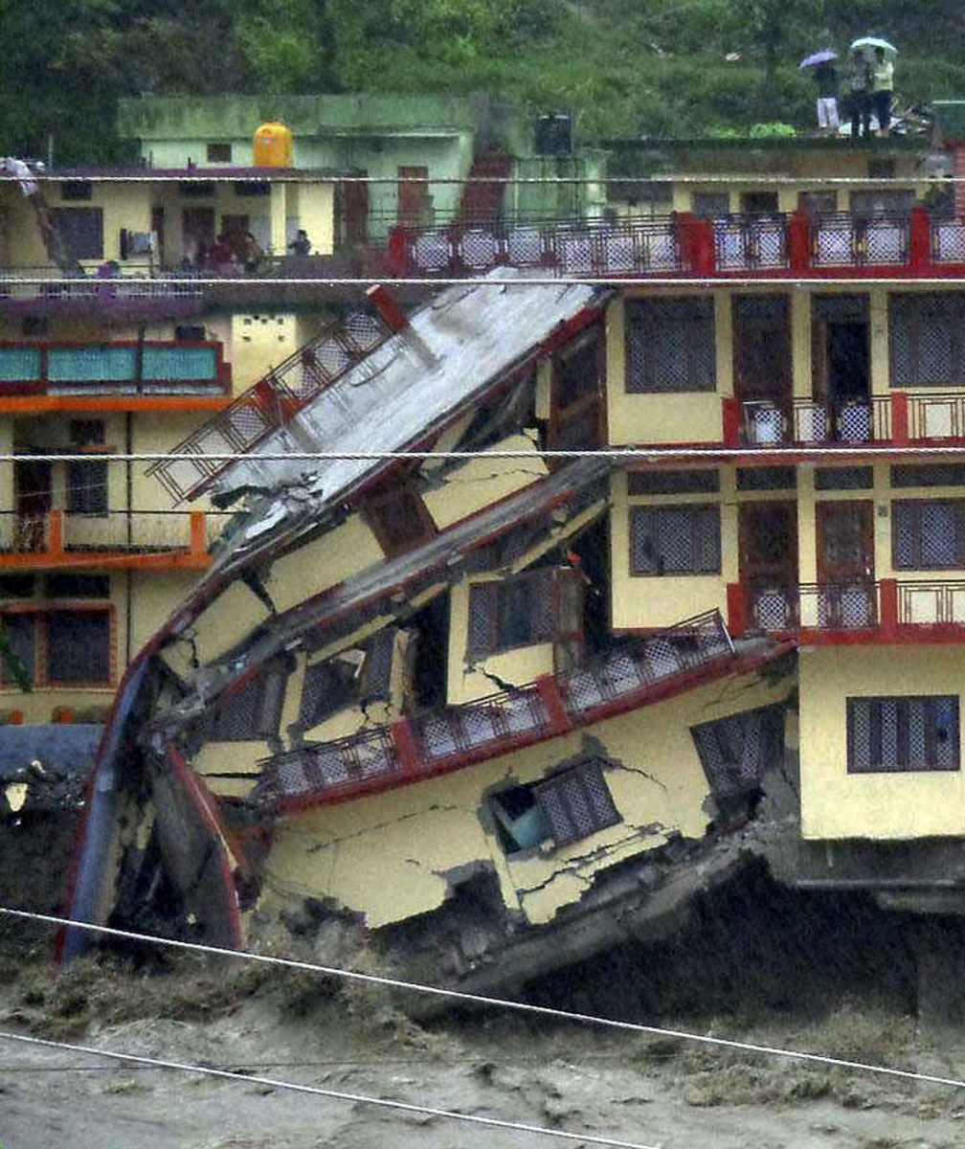
© Brain Wrinkles

Slide 31
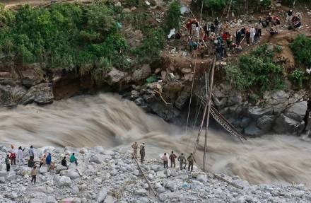
© Brain Wrinkles

Slide 32
Flooding in
CHINA
© Brain Wrinkles

Slide 33
Monsoons
In China, monsoon season begins in March and spreads heavy rain until August.
Monsoons are also a mixed blessing for China.
Farmers benefit when the Yangtze and Huang He Rivers overflow their banks because the silt and algae left behind provides fertile soil.
However, when monsoon rains swell the rivers too much, it leads to terrible destruction.
© Brain Wrinkles

Slide 34
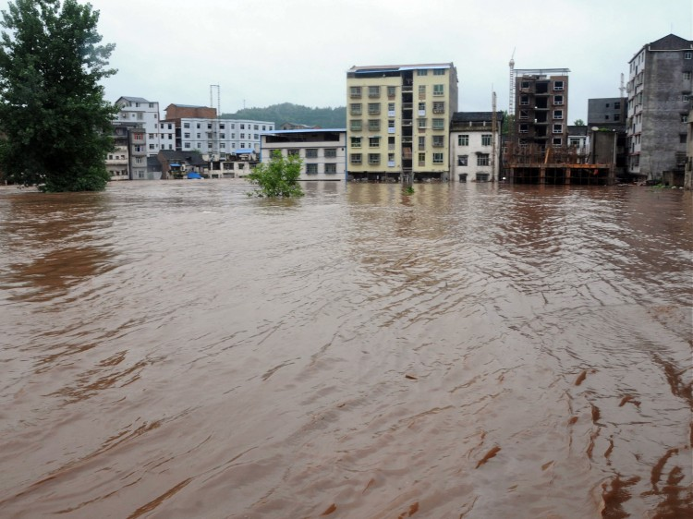
© Brain Wrinkles

Slide 35
Flooding
Loggers have cut down many of the trees that used to contain the rivers’ flooding.
Farmers downstream have also drained wetlands that used to act as sponges during floods.
Deforestation and draining have multiplied the effects of the storm water runoff and it now takes much less water to cause a flood.
© Brain Wrinkles

Slide 36
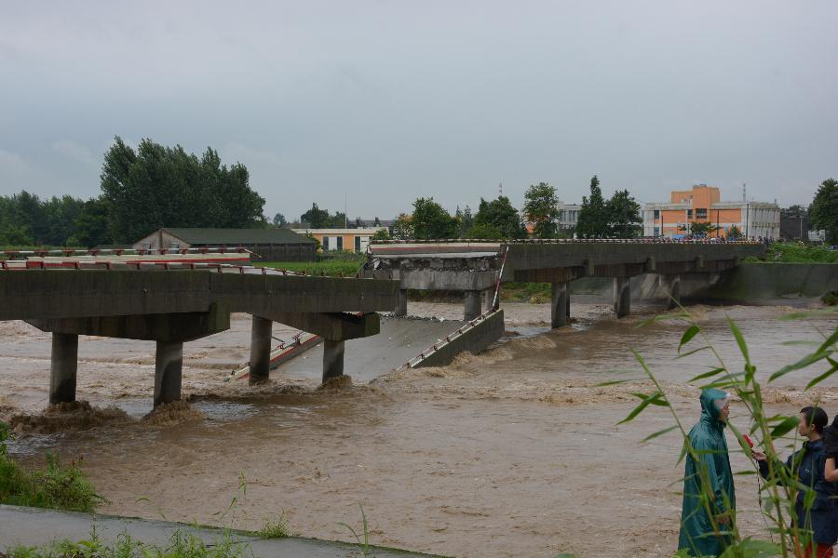
© Brain Wrinkles

Slide 37
Effects
Monsoons usually cause floods every two or three years in China.
When the river floods, homes and crops are buried and lives are lost.
Flooding from China’s Huang He River has caused more deaths than any other river in the world.
Because of this, the river is often called “China’s Sorrow”.
© Brain Wrinkles

Slide 38
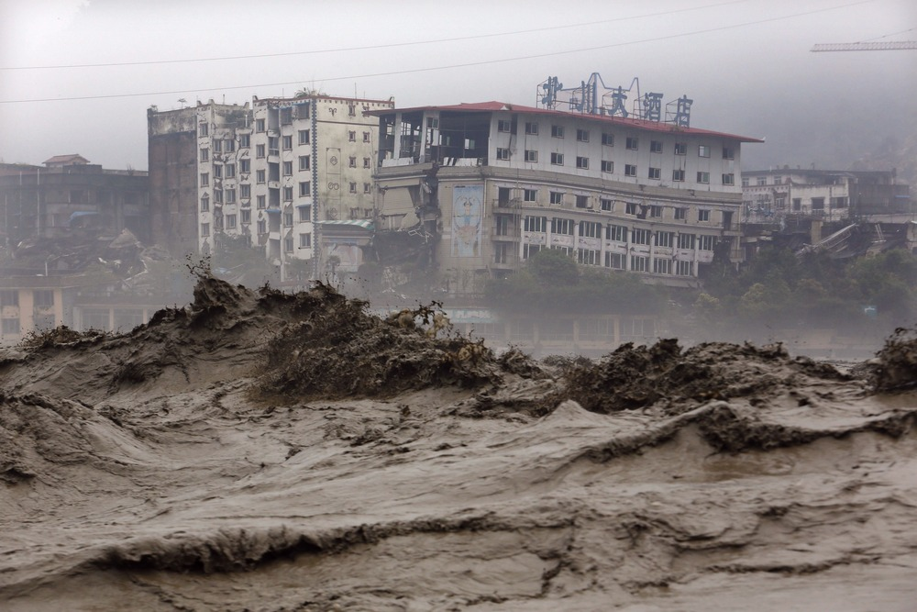
© Brain Wrinkles

Slide 39
Solutions?
The Chinese have built dams to control the rivers.
Unfortunately, when the dams burst during monsoon season, the flooding problem actually becomes much worse.
© Brain Wrinkles

Slide 40
Air Pollution in
INDIA
© Brain Wrinkles

Slide 41
Causes
India has some of the heaviest air pollution in the world due to automobile emissions and the development of industry.
Many of India’s industries use coal to power their factories.
When coal burns, it releases harmful gases and pollutants into the atmosphere.
© Brain Wrinkles

Slide 42
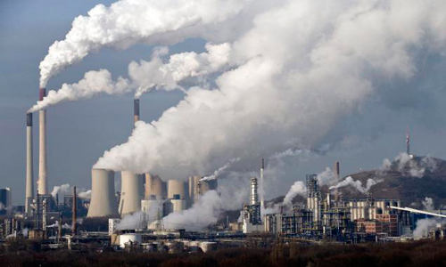
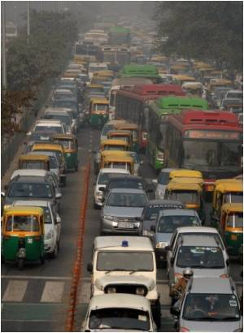
© Brain Wrinkles

Slide 43
Causes
Indoor air pollution is also a growing problem in India.
In rural areas, many families cook over open fires, using wood, livestock dung, or coal as fuel.
These fuel sources emit carbon monoxide, soot, and other toxic fumes into the air.
© Brain Wrinkles

Slide 44
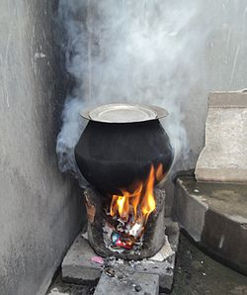
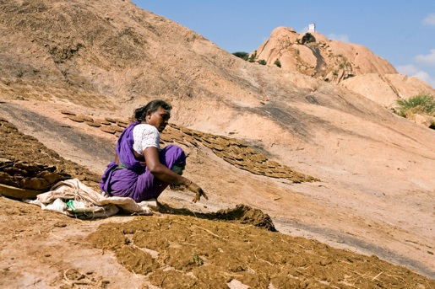
“Cooking fuel in rural India is prepared from a wet mix of dried grass, fuelwood pieces, hay, leaves and mostly cow/livestock dung. This mix is patted down into disc-shaped cakes, dried, and then used as fuel in stoves. When it burns, it produces smoke and numerous indoor air pollutants at concentrations 5 times higher than coal.”
© Brain Wrinkles

Slide 45
Effects
Because of India’s rapidly growing population, more and more Indians are exposed to pollution every year.
Indians living in cities have some of the highest rates of respiratory disease in the world.
Air pollution is now the fifth leading cause of death in India.
© Brain Wrinkles

Slide 46
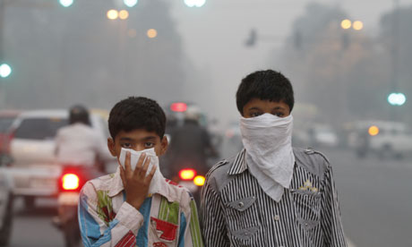
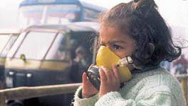
© Brain Wrinkles

Slide 47
Effects
The Taj Mahal, a sacred site and popular tourist destination, is growing yellow from high levels of air pollution.
Some scientists believe that Indian smog could potentially change weather patterns in North America.
© Brain Wrinkles

Slide 48
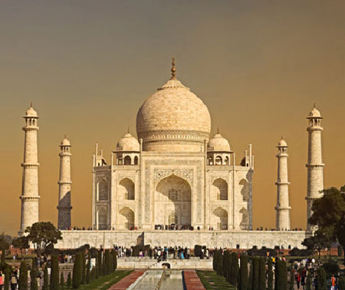
© Brain Wrinkles

Slide 49
Solution?
It has been very difficult for India’s government to enforce laws on industry and transportation to clean up the air because it would impact the economy.
A large part of India’s population is very poor and does not want anything to slow down economic growth.
India has been investing money in clean up efforts, but it has not proved to be enough.
© Brain Wrinkles

Slide 50
Air Pollution in
CHINA
© Brain Wrinkles

Slide 51
China
China’s cities have experienced tremendous growth in population and industry in the past few decades.
16 of the world’s 20 most polluted cities can be found in China!
China alone pumps 1/3rd of the entire world’s total pollutants into the atmosphere.
© Brain Wrinkles

Slide 52
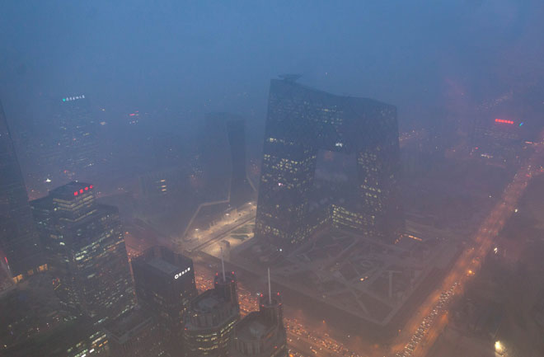
© Brain Wrinkles

Slide 53
Causes
Much of China’s energy is provided by burning coal, a process that sends soot, ash, and chemicals into the air.
Chinese citizens also burn coal to heat their homes, which adds to the pollution problem.
Millions of Chinese people now drive automobiles, whose exhaust is also a major source of air pollution.
© Brain Wrinkles

Slide 54
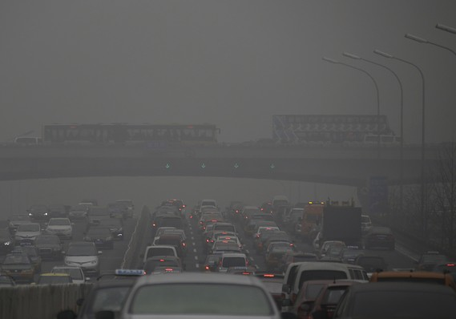
© Brain Wrinkles

Slide 55
Effects
The leading causes of death in China are heart and respiratory conditions related to overexposure to air pollution.
It is estimated that only 1% of people who live in China’s cities breathe safe air.
Air pollution has also created acid rain in China, a problem for at least a third of the country’s agricultural areas.
© Brain Wrinkles

Slide 56
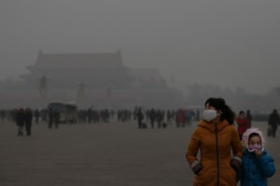
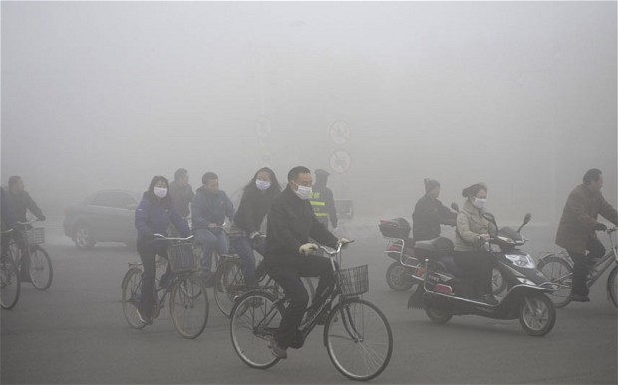
© Brain Wrinkles

Slide 57
Effects
Unfortunately, air pollution created in Chinese cities is not confined inside the country.
Winds carry the contaminated air and rain to Korea, Japan, and other parts of Asia as well.
Scientists have even discovered Chinese-created air pollutants over the west coast of the US.
© Brain Wrinkles

Slide 58
Solution?
China’s government pledged to work on the quality of the city’s air before the 2008 Olympics.
Automobile traffic was greatly reduced and many factories were temporarily closed.
Air pollutants were cut by as much as 45%.
Many people enjoyed the cleaner air and petitioned the government to find long-term ways to clean it up.
© Brain Wrinkles

